Slide 1

AI-Driven Retail Optimization: Demand Prediction, Inventory Management

Slide 2
Operational Challenges in Retail Management
Retailers must balance demand forecasting, pricing, and inventory control
Overstocking increases storage costs and waste
Understocking results in lost revenue and customer dissatisfaction
Promotions and competitor pricing add complexity to demand behavior

Slide 3
Project Objectives: Unlocking Retail Insights
Analyze Sales Patterns
Pricing & Promotion Impacts
Identify Inventory Risks
Examine historical sales and seasonality to understand trends.
Quantify how pricing and promotions influence customer demand.
Pinpoint overstock and stockout risks across products and stores.
Develop Prediction Model
Generate Actionable Insights
Create a baseline machine learning model for demand forecasting.
Generate insights to support demand forecasting
and inventory management

Slide 4
Data Sources and Integration
Inventory Dataset
Pricing Dataset
Stock levels and reorder point data used to assess inventory risk
Product prices, competitor prices, and discount information used for demand analysis
Demand Dataset
Historical sales quantities, promotional indicators, and temporal information
All datasets were cleaned, standardized, and integrated using Product ID and Store ID
The resulting dataset provides a unified view of demand, inventory, and pricing factors

Slide 5
Analysis Workflow – From Data to Decisions
Data Cleaning & Integration
Merged demand, inventory, and pricing datasets by Product ID and Store ID
Feature Engineering
Created time-based features: Month, Weekday
Added binary indicator for promotions
Generated lagged sales feature to capture recent trends
Exploratory Data Analysis (EDA)
Analyzed sales trends over time
Examined inventory distribution across stores and products
Explored price vs. sales relationships and promotional impacts
Correlation analysis to identify key drivers of demand
Predictive Modeling
Random Forest Regression to forecast sales
Input features: time, promotions, inventory, pricing, lagged sales
Chronological train-test split to preserve temporal patterns
Evaluation & Insights
Model assessed using MAE, RMSE, R², and MAPE
Feature importance analyzed to identify key demand drivers
Inventory risk and stock status classified for operational insights
Removed duplicates, standardized numeric columns, handled missing values

Slide 6
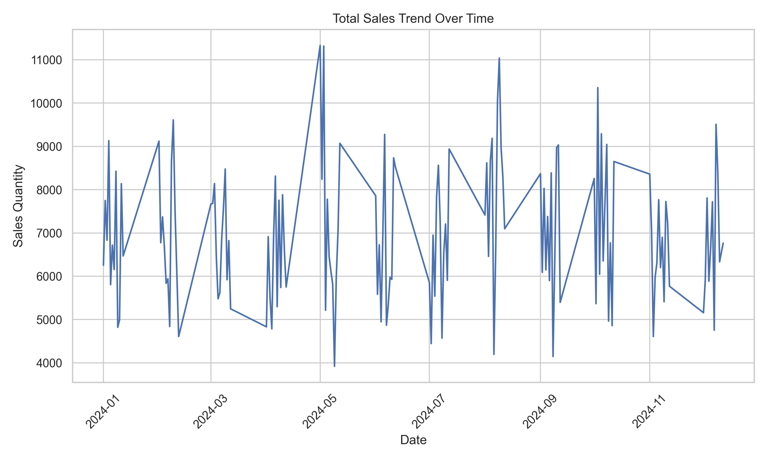
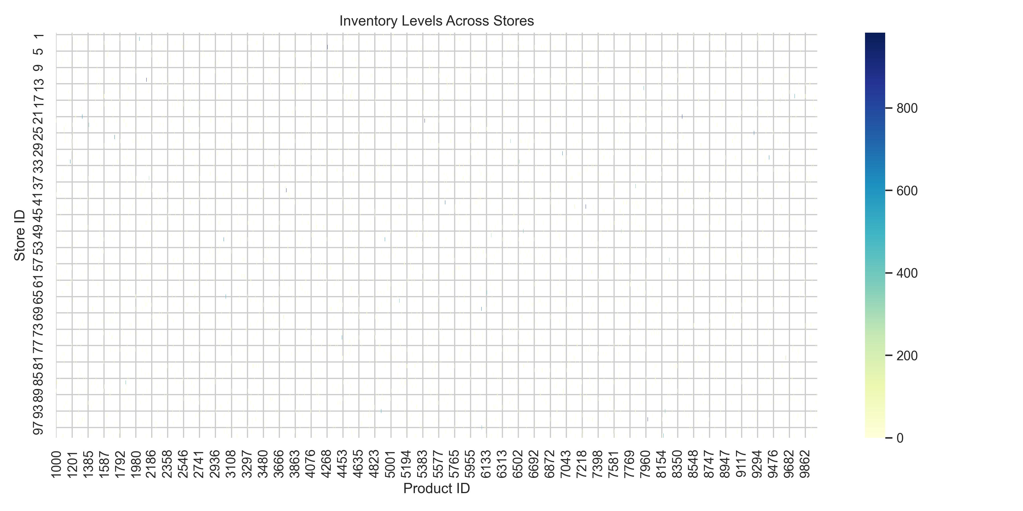
Sales Trend & Inventory Insights
Figure 1. Total Sales Trend Over Time
Figure 2. Inventory Levels Across Stores

Slide 7
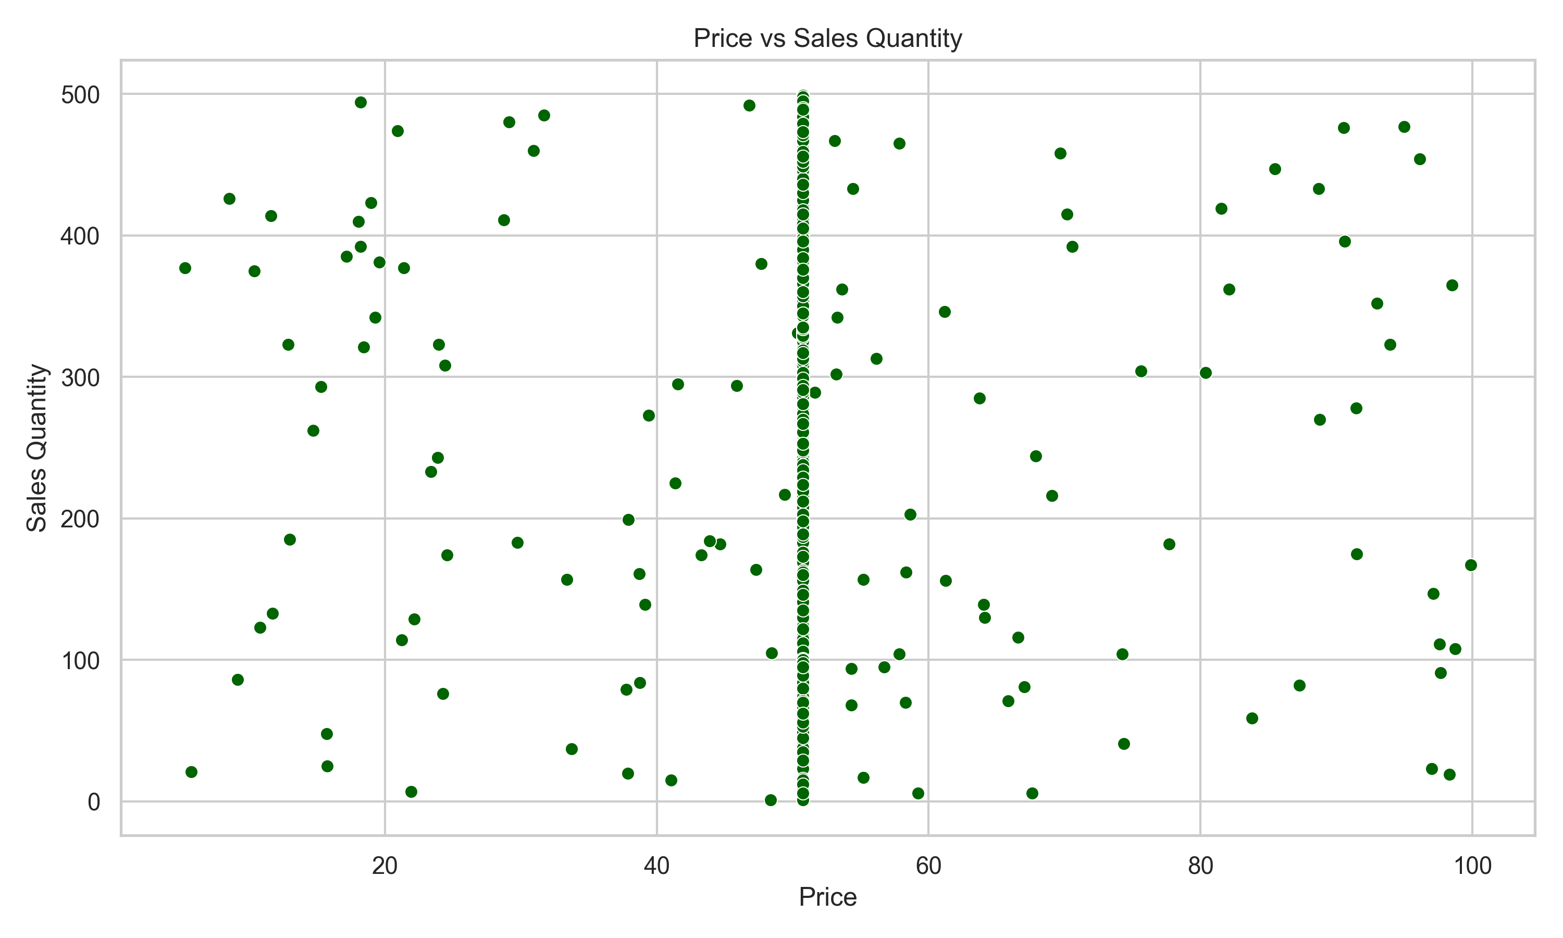
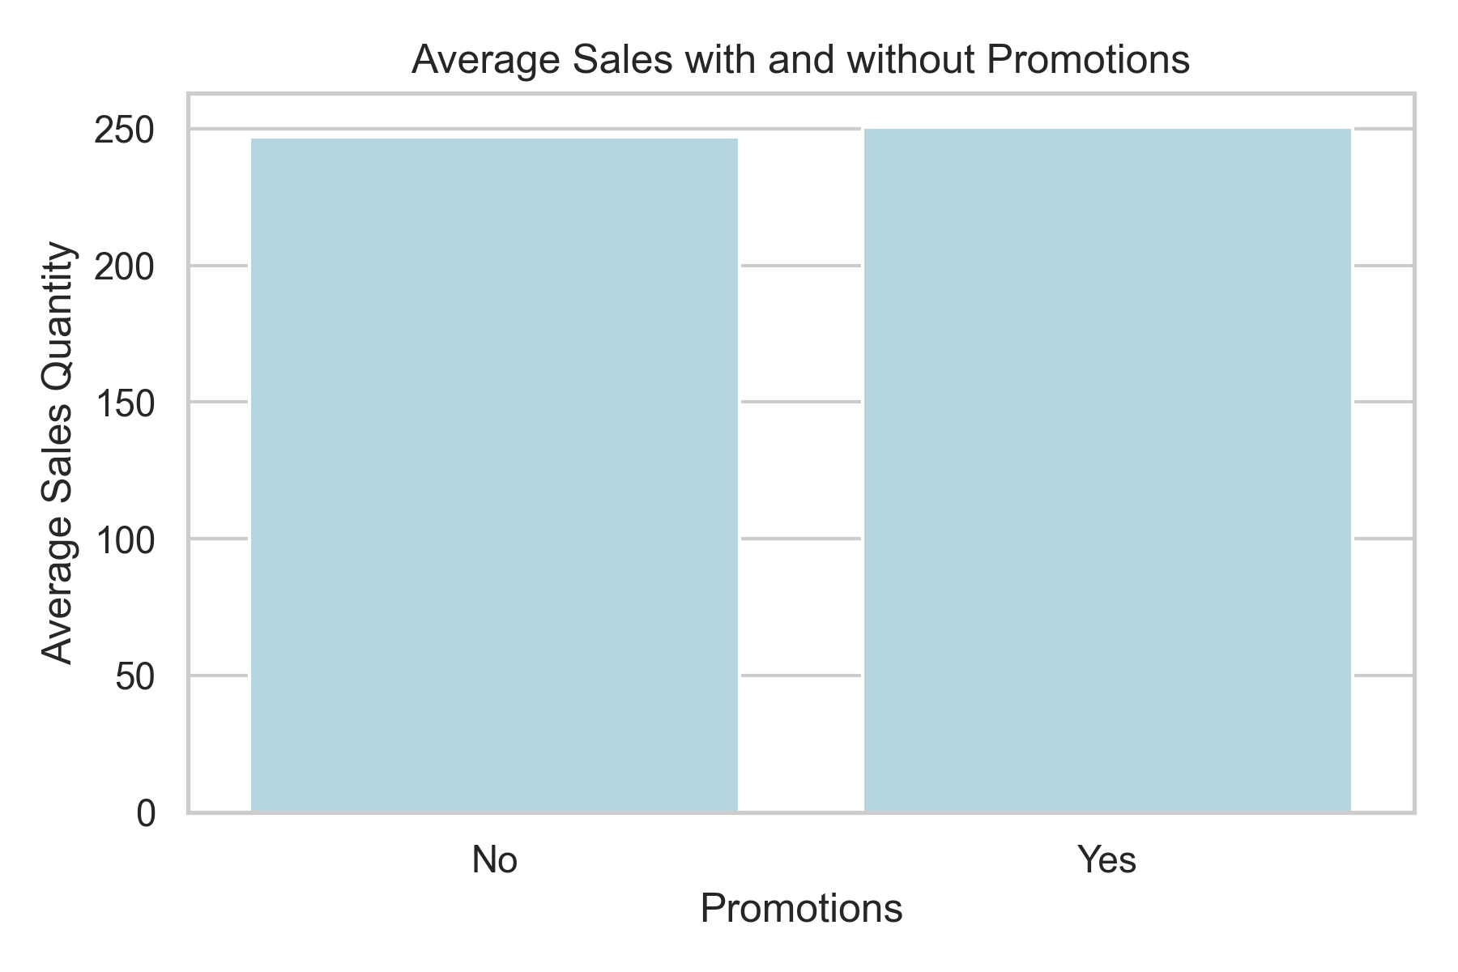
Pricing & Promotion Effects
Figure 3. Price Compared to Sales Quantity
Figure 4. Average Sales with and without Promotions

Slide 8
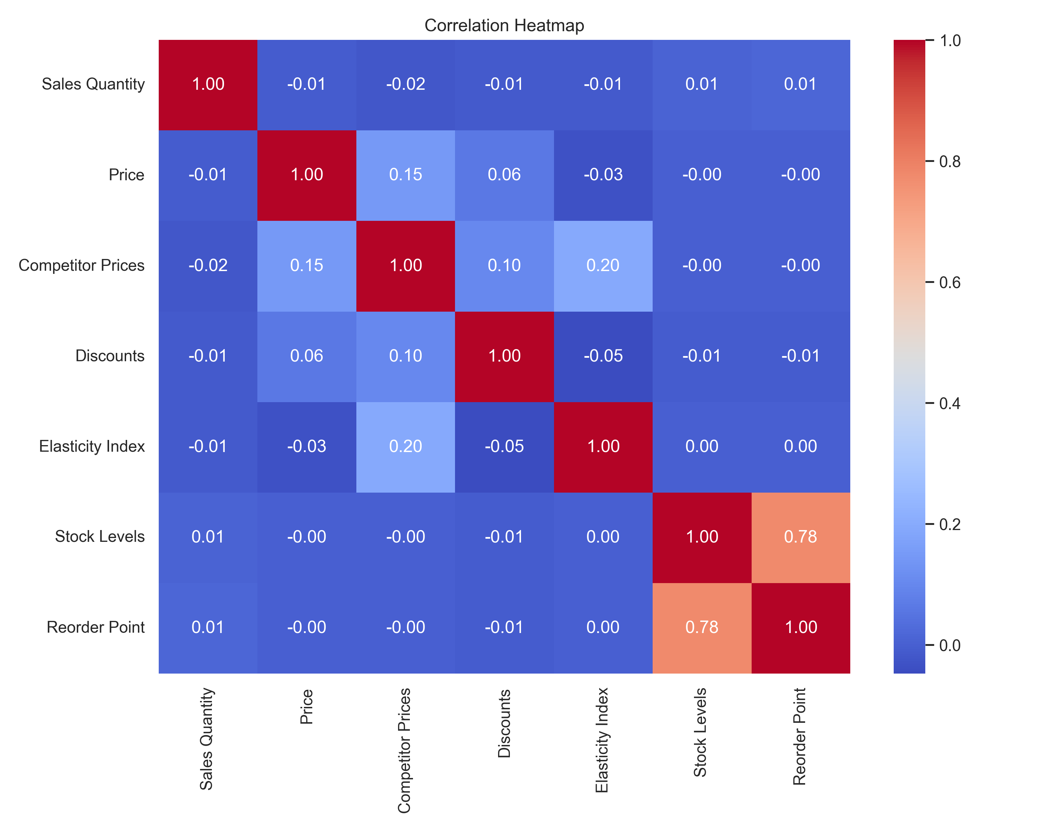
Correlation Analysis
Examined relationships between sales, inventory, pricing, and promotions
Positive correlation observed between sales and stock levels
Negative correlation observed between sales and price
Highlights key drivers of demand and areas for operational focus

Slide 9
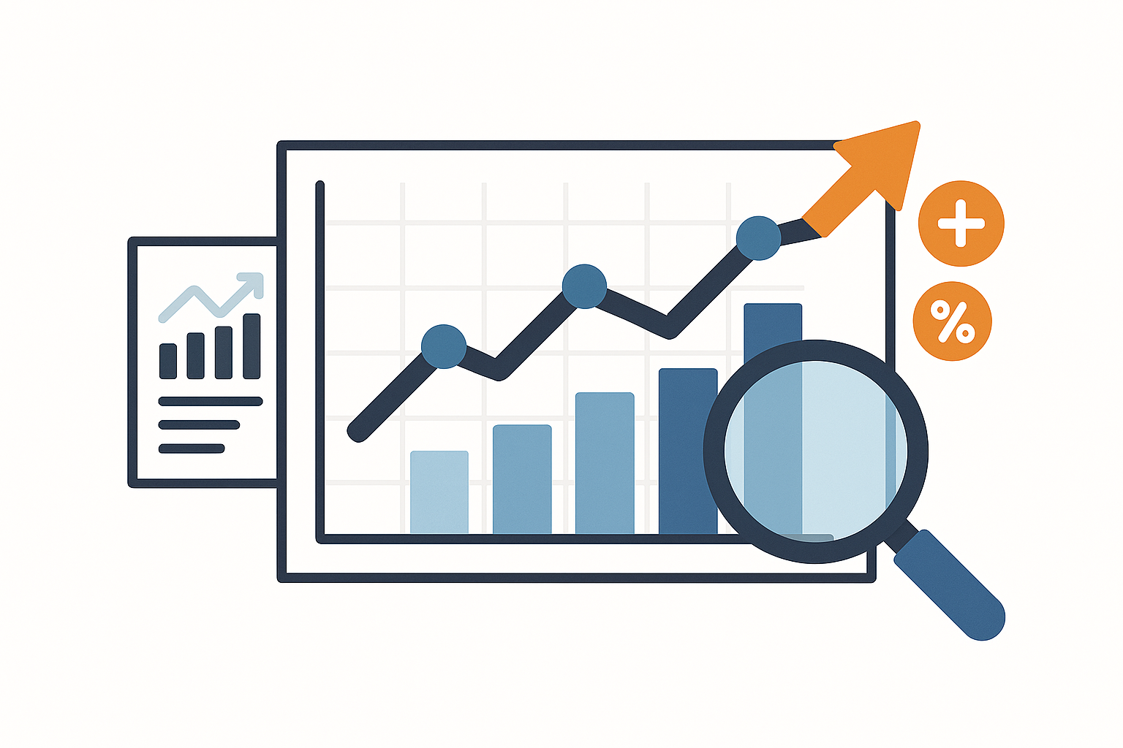
Demand Forecasting Model
Random Forest Regression model was built to forecast sales
Captures non-linear relationships and feature interactions
Input features includes,
  Time: Month, Weekday
  Promotions: Binary indicator
  Inventory metrics: Stock levels, Reorder points
  Pricing: Price, Competitor Prices, Discounts
Lagged sales to capture recent trends
Chronological train-test split ensures temporal integrity

Slide 10
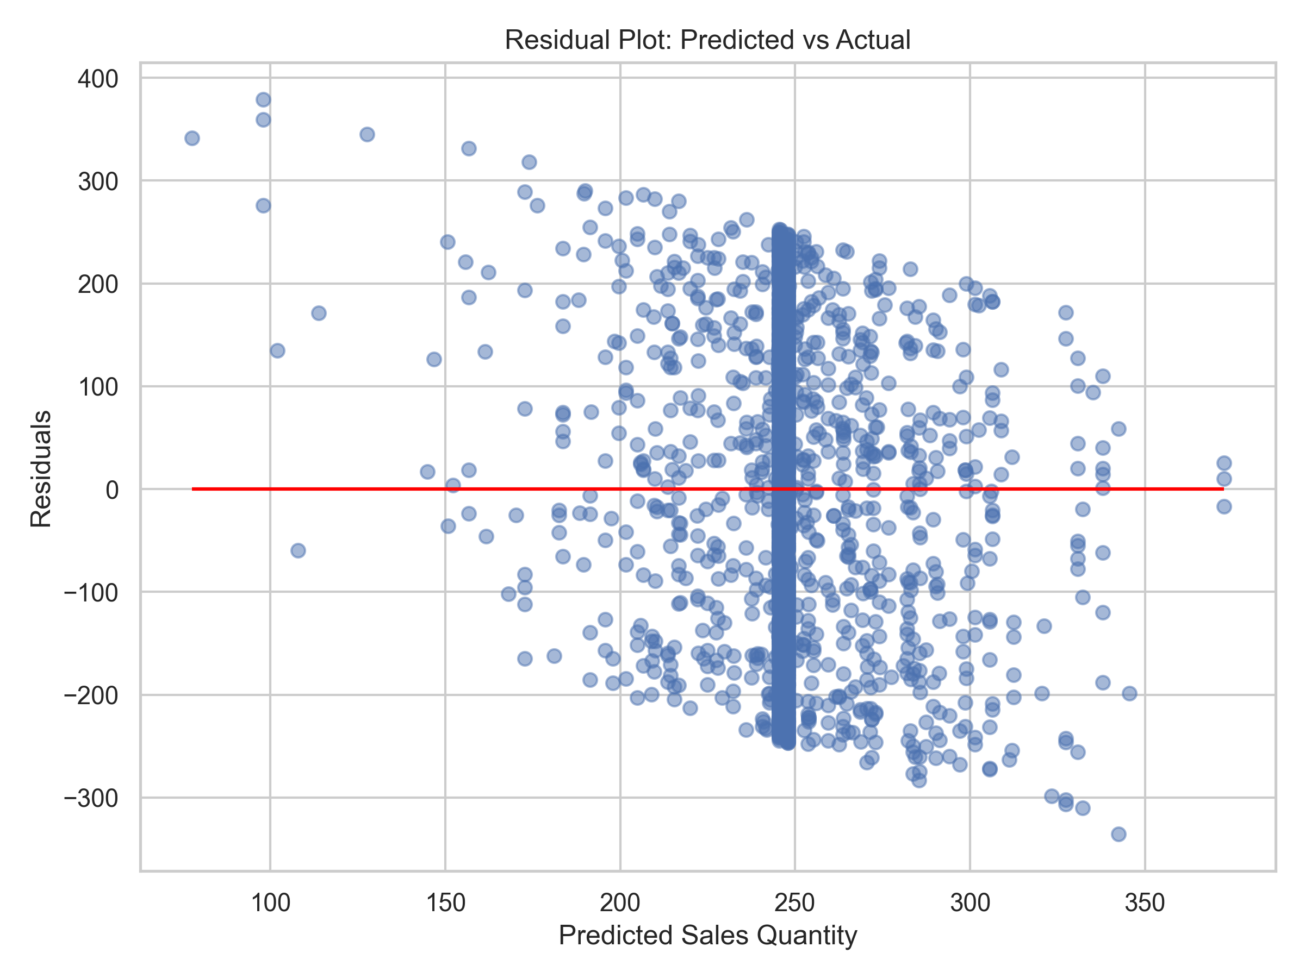
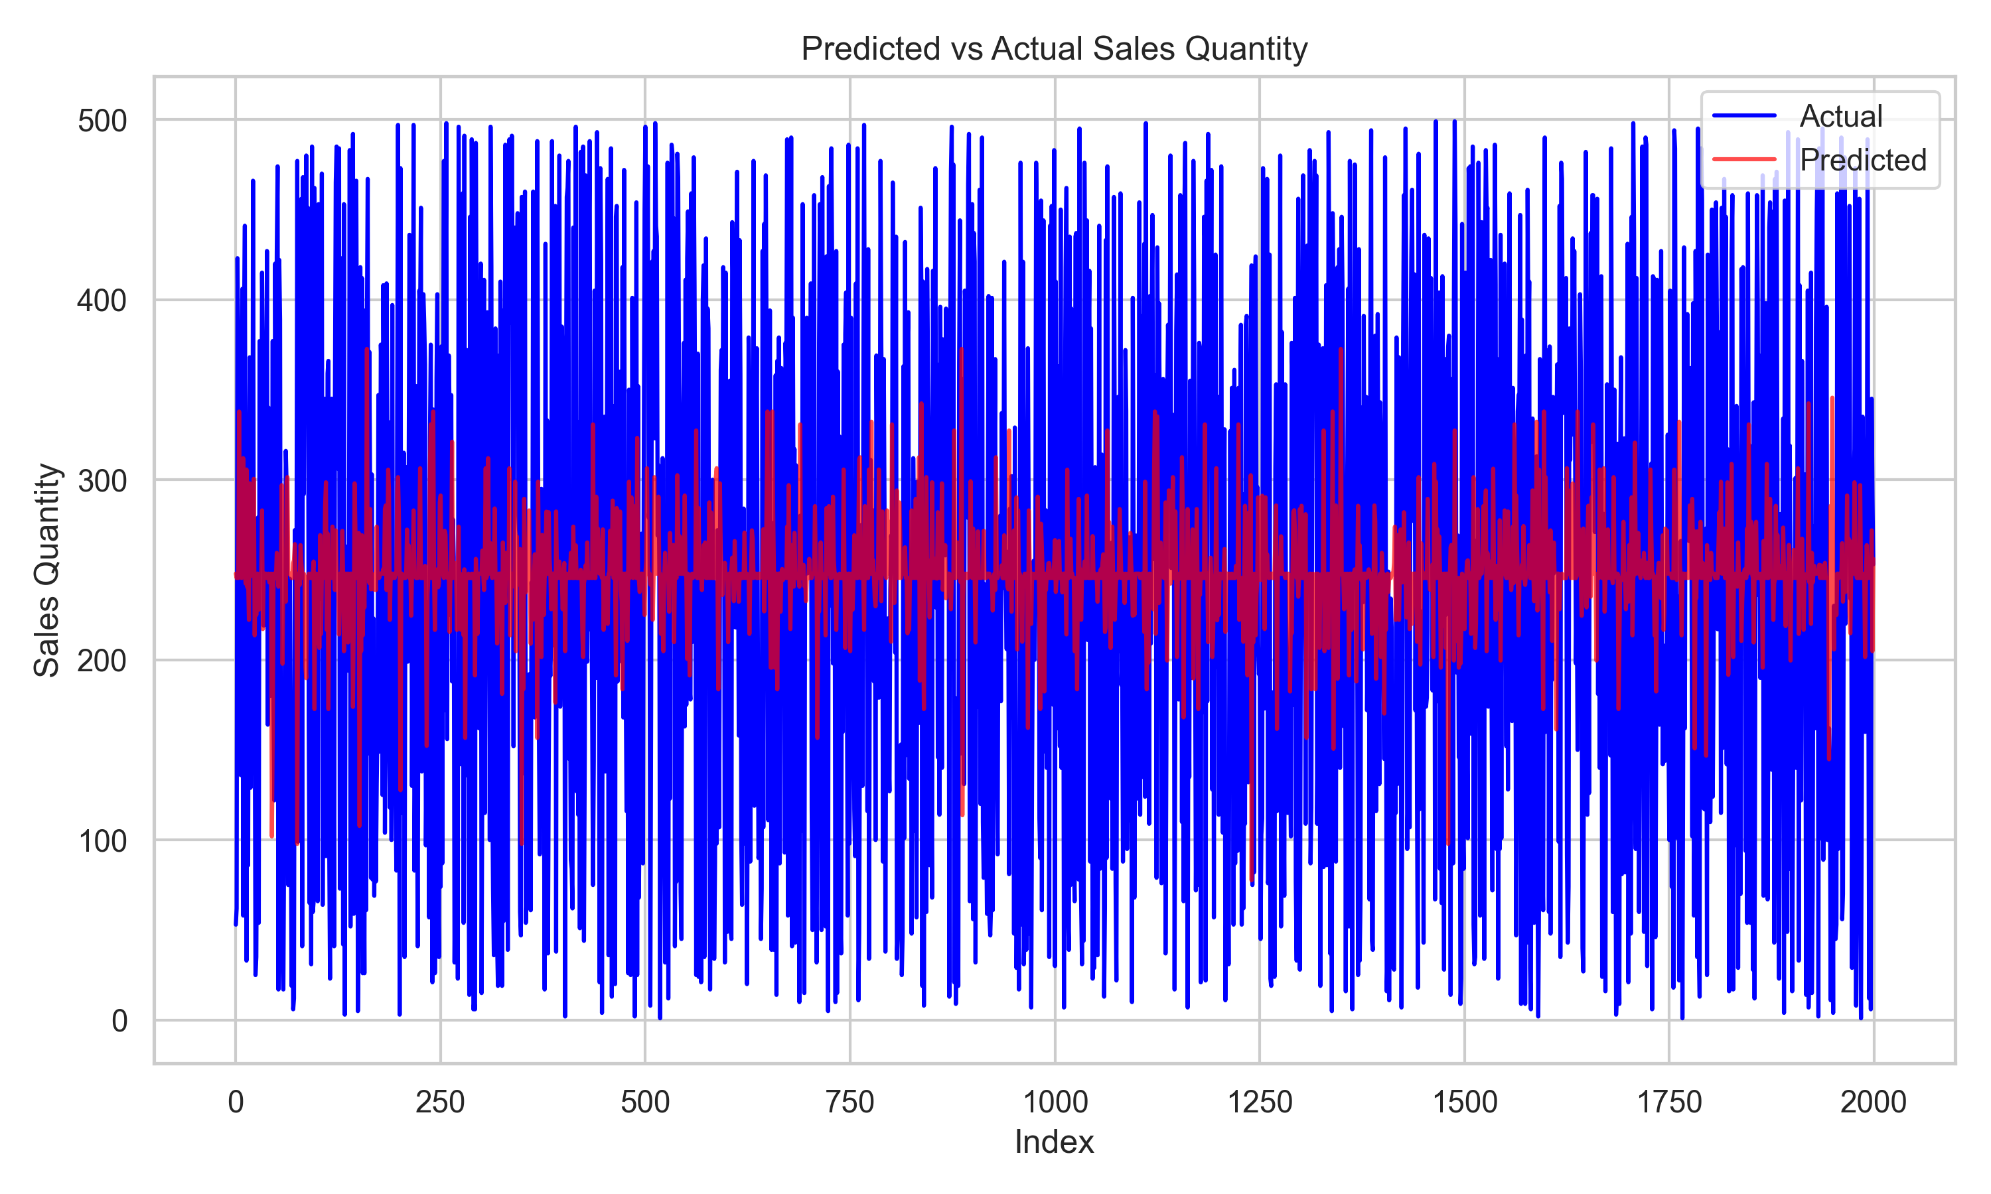
Model Evaluation
Below are the metrics from model performance evaluation,
  MAE (Mean Absolute Error): 125.55
  RMSE (Root Mean Squared Error): 146.29
  R² Score: -0.036
  MAPE (Mean Absolute Percentage Error): 260.44
Residual analysis and predicted vs actual plots used to assess accuracy and trends
Evaluation metrics highlight that, while the model reflects overall demand patterns, its low R² and high MAPE confirm it is exploratory and not suitable for production deployment.

Slide 11
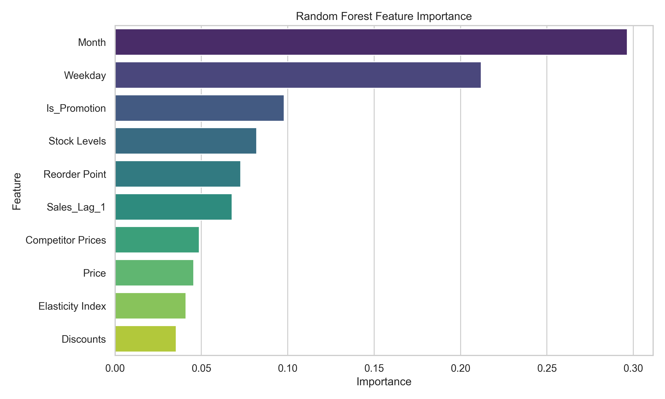
Feature Importance & Insights
Sales are primarily driven by temporal patterns, promotions, and inventory levels, while pricing features have lower impact in this baseline model, guiding inventory and promotion planning.

Slide 12
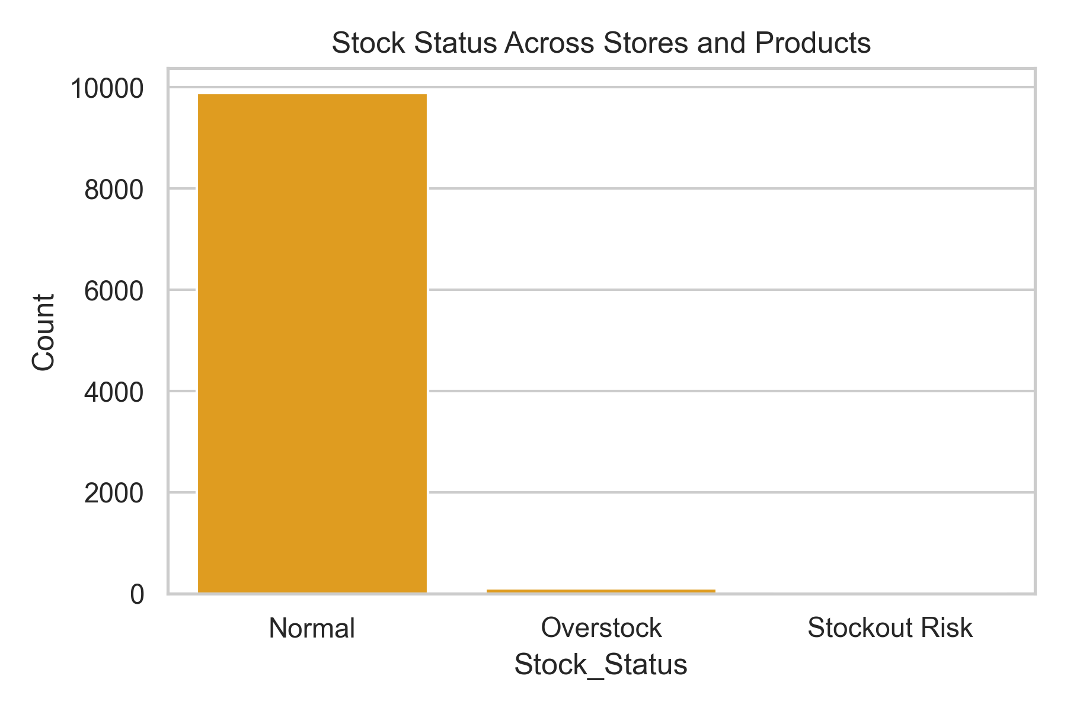
Stockout / Overstock Analysis
Overstocked products tie up capital
Stockout-risk products may lead to lost sales
Most products at optimal inventory levels
Supports prioritization of restocking and inventory adjustments

Slide 13
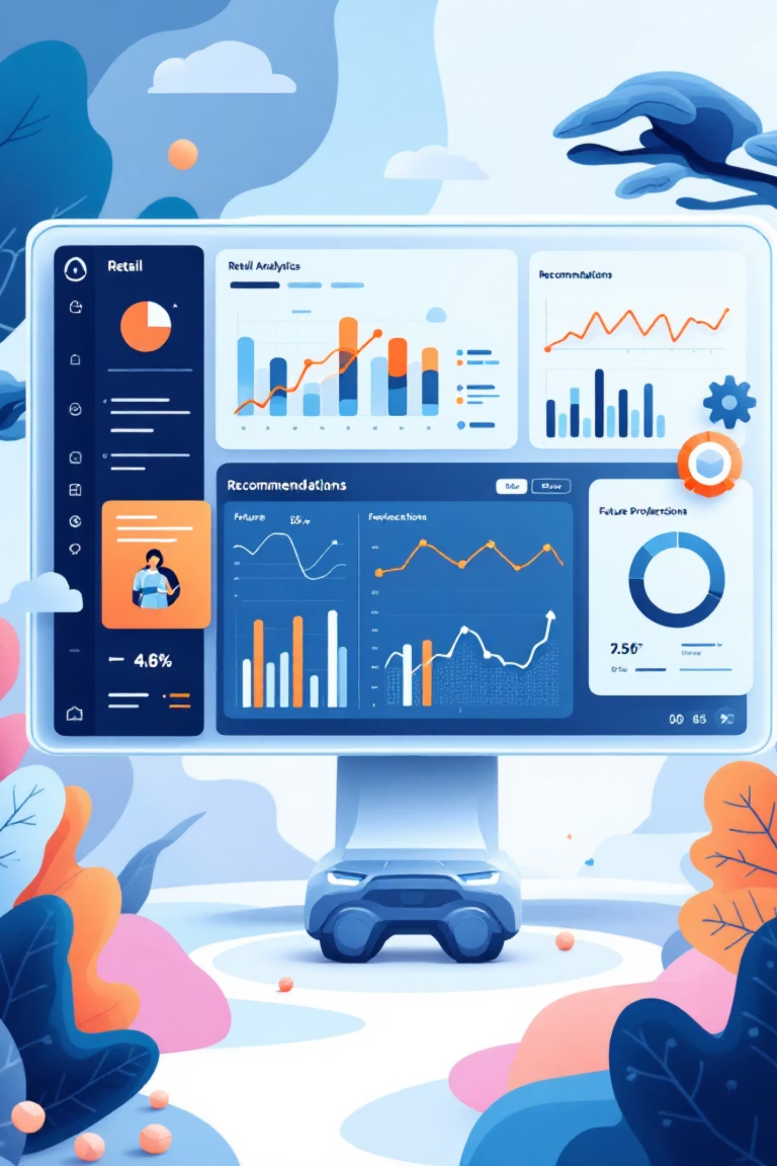
Business Insights & Recommendations
Business Insights
Promotions significantly boost demand
Inventory availability directly impacts sales
Temporal patterns dominate demand & behavior
1
Recommendations
Align inventory with reorder thresholds
Focus promotions during high-demand periods
Use AI forecasts for operational decision-making
2
Future Work
Explore advanced models (XGBoost, Neural Networks)
Integrate external factors (holidays, weather)
Automate replenishment systems
3

Slide 14
Ethical Considerations & Challenges
Ethical Considerations:
Customer and sales data anonymized for privacy.
Model monitored to prevent bias toward certain products, stores, or segments.
Transparent documentation ensures stakeholder trust.
Challenges:
Merging datasets with differing formats and time intervals.
Limited coverage of external factors (holidays, weather).
Balancing model accuracy with interpretability.

Slide 15
Thank You !!!

